Slide 1
Unit 0
History Before 1200

Slide 2
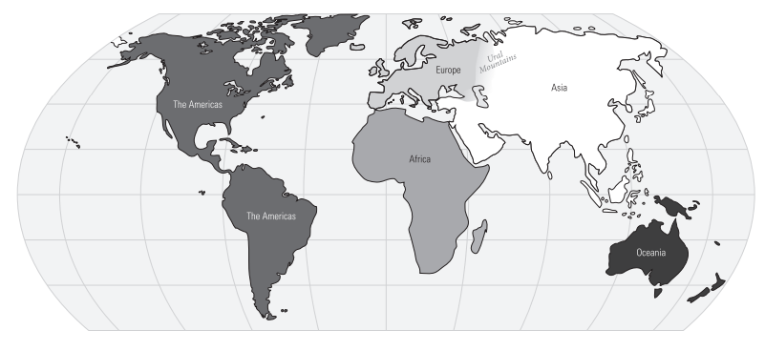
Must Know AP Maps/Regions

Slide 3
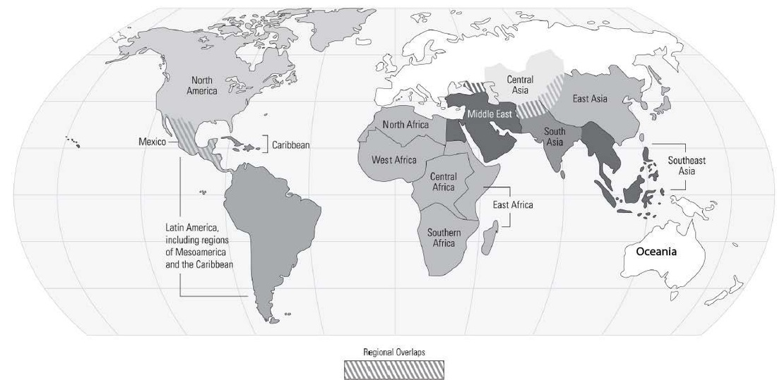
Must Know AP Maps/Regions

Slide 4
Lesson 1:
Human Development to 600 BCE

Slide 5
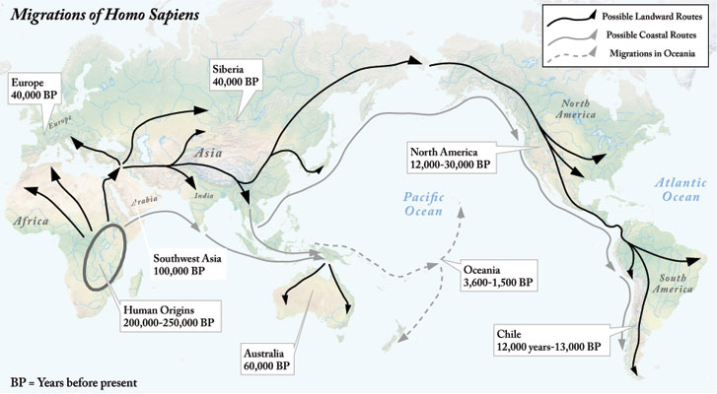
Which continent did humans emerge from?
In what ways did geography affect human migration and how did humans adapt?
Notes:
https://whfua.history.ucla.edu/images/bigeras/era2/migrations_of_homo_sapiens_map.jpg

Slide 6
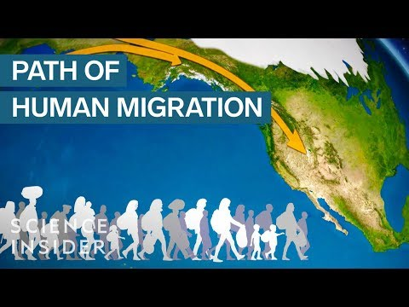
Notes:
Peopling of the earth / Out of Africa

Slide 7
The First Migrations
Modern humans emerged in East Africa between 200,000 BCE and 100,000 BCE.
They typically lived in small groups and hunted and foraged their food.
They adapted to their environment as needed.
How do you think early modern humans would have to adapt to their environment?
They developed animism as a form of religion that focused on nature.

Slide 8
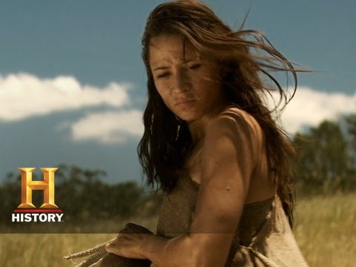
The Agricultural Revolution
What did farming allow humans to do?
What benefits does farming have?
Any disadvantages?
How does farming allow societies and civilizations to develop?
Notes:
https://www.youtube.com/watch?v=bhzQFIZuNFY&t=95s

Slide 9
The Agricultural Revolution
Around 8,000 BCE (10,000 years ago), humans began to plant crops and domesticated animals for food.
People began to produce a surplus of food which enabled them to begin specialization of labor (since not everyone had to be focused on food)
The population grew
Settlements were able to grow which lead to cities.
People became highly skilled at one job. Artisans made tools and weapons, Merchants engaged in trade. etc
New technologies developed, such as irrigation, the wheel, metal (bronze and iron) tools and art
People created more extensive governments and taxation. Desire to keep records led to the invention of writing
Competition for resources and accumulation of wealth increased group conflicts.
People became divided up into social classes by wealth and occupation.
Status of women declined as patriarchal societies became to develop.

Slide 10
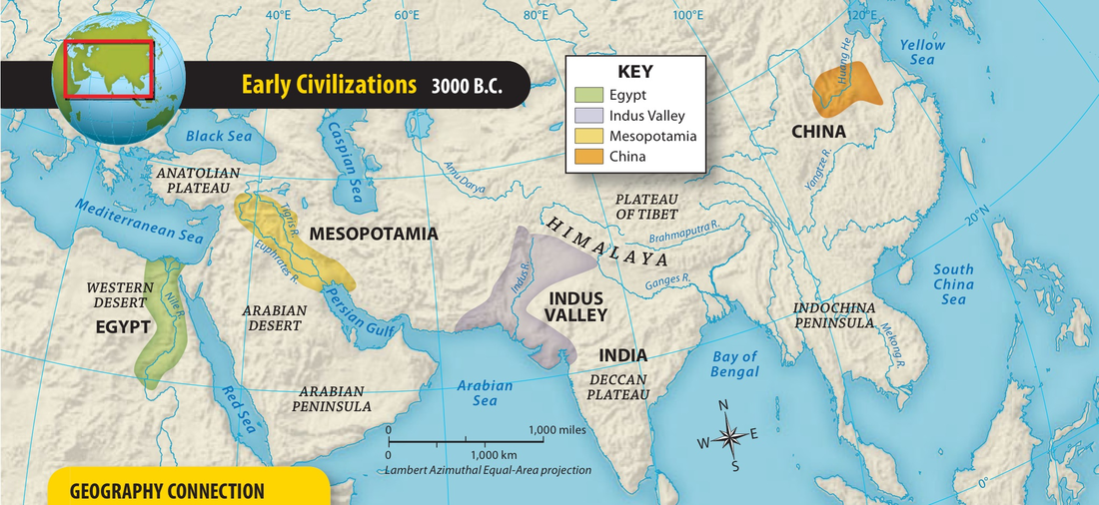
The First Civilizations
Looking at the 4 early civilizations, what do these areas have in common? What advantages and/or disadvantages in term of location do you see?

Slide 11
Crash Course Videos
#1 - Mesopotamia
#2 - Ancient Egypt
#3 - The Indus River Valley Civilization
#4 - China

Slide 12
Part 2:
The Classical Era: c.600 BCE-c.600 CE

Slide 13
Major Classical Empires, c. 600 BCE to c. 600CE
Western Eurasia: the Persian, Greek, Roman, and Byzantine empires
Southern Asia: the Mauryan and Gupta Empires
Eastern Asia: The Qin and Han dynasties
Mesoamerica: the MAyan Empire
Goods and ideas spread along land routes such as the Silk Roads and maritime routes in the mediterranean sea and Indian Ocean.
Major great cities: Rome (Italy), Constantinople (Turkey), Damascus (Syria), Pataliputra (India), and Chang’an (China)

Slide 14
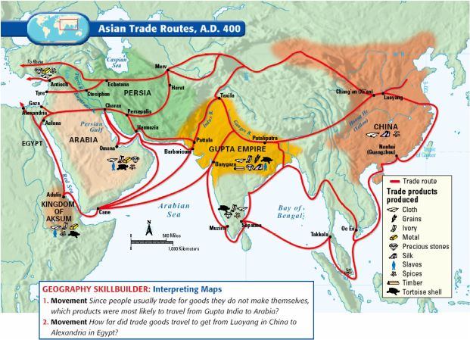

Slide 15
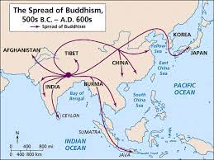
Buddhism & Developments in South Asia
Buddhism provided an alternative to Hinduism. Because it rejected the caste system.
Buddhism was spread by missionaries and merchants along the silk road and Indian Ocean trade routes.
Considered an universalizing religion that sought converts among all people.
Focus on monastic communities for men and women

Slide 16
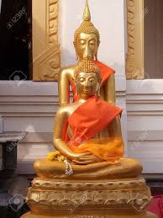
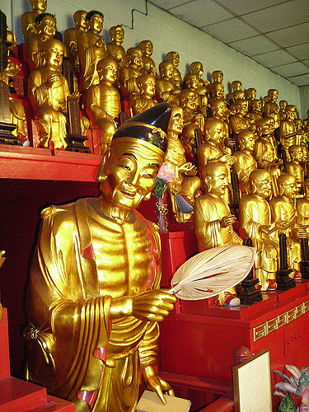
Changes in Buddhism
Theravada Buddhism
Mahayana Buddhism
Gautama and other Buddha’s are popular.
Everyone can achieve nirvana at the end of one's life.
The journey to nirvana is a group journey
Popular in East Asia
Only historical Buddha is accepted
Best way to achieve nirvana is by being a monk or nun.
The journey to nirvana is an individual journey
Popular in Southeast Asia

Slide 17
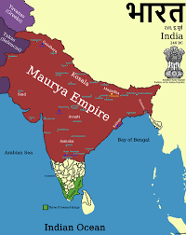
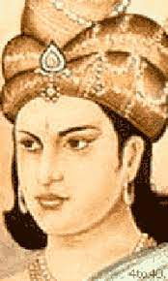
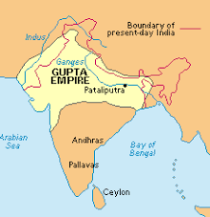
Mauryan Empire
Gupta Empire
322 BCE-187 BCE
Ashoka-promoted prosperity by creating an efficient tax system and building roads. Converted to buddhism and assisted in its spread throughout India
Political decentralization resulted in decline of power
320 CE- 550 CE
Golden Age of India
Centralized government
Public hospitals, advanced numbering system (included zero),
Supported Hinduism

Slide 18
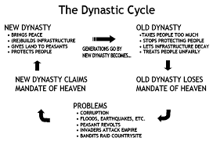
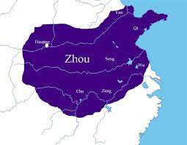
Developments in E. Asia
Zhou Dynasty: 1076 BCE-256 BCE-unified central China
Mandate of Heaven

Slide 19
Confucianism
Daoism (Taoism)
Founder: Confucius-The Analects-described how people should heave in everyday life.
Does not focus on a deity but rather focuses on education, benevolence, virtue, respect for authority, and patriarchal social structure.
Emphasizes filial piety (duty of people to honor ancestry)
Focused on how people could live in harmony with nature.
Emphasized internal reflection more than external behavior.

Slide 20
The Five Key Relationships - Confucianism
 | Superior | Inferior
Most important | Ruler | Subject
Filial Piety | Father | Son
Only mention of a woman | Husband | Wife
 | Older brother | Younger brother
 | Friend | Friend
Notes:
Understanding the guiding force of Chinese Society

Slide 21
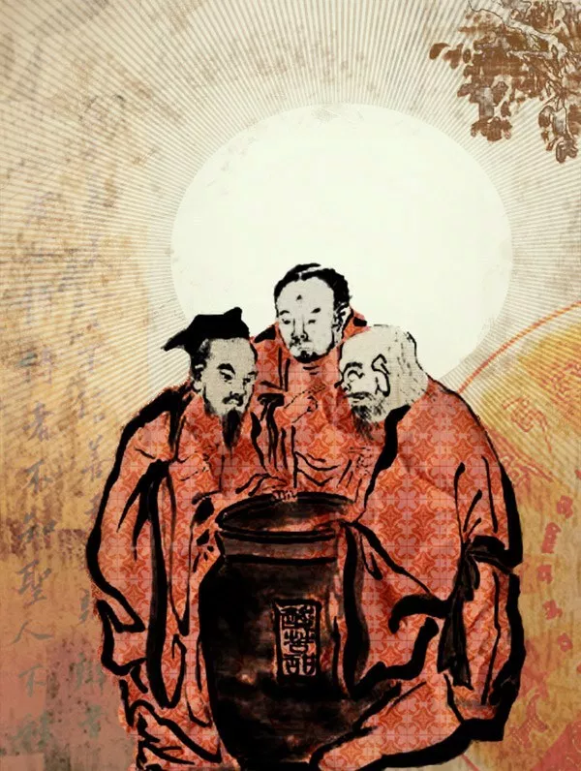
The Vinegar Tasters
Left to right
Confucius (sour), Buddha (bitter), Laozi (sweet)

Slide 22
Qin Dynasty
Han Dynasty
221 BCE- 207 BCE
Standardized Chinese script, established uniform system of weights and measures and built canals and roads
Increased trade and prosperity
206 BCE-220CE
Peaceful
Population grew
New advances in science and technology (magnetic compass, paper, etc)
Trade extended from Chang’an to Mediterranean Sea (such as spices, germs, metals, tea, and silk)
Civil Service Exam: requires students to analyze confucian teaching-those who scored well got jobs in the government.

Slide 23
Civilizations of Western Eurasia & Christianity
Persia-developed around 559 BCE under Cyrus the Great--Strong centralized government, efficient imperial bureaucracy, advanced road system (Royal Roads); Promoted trade, prosperity, and stability, Religious tolerance, ethnically and religiously diverse
Greece-1000 city-states; did not unify due to mountainous terrain and numerous islands; Polytheistic religion;
Sparta-militaristic patriarchal society;
Athens-Democracy; free adults males could participate in government; advancements in literature, theater, and philosophy

Slide 24
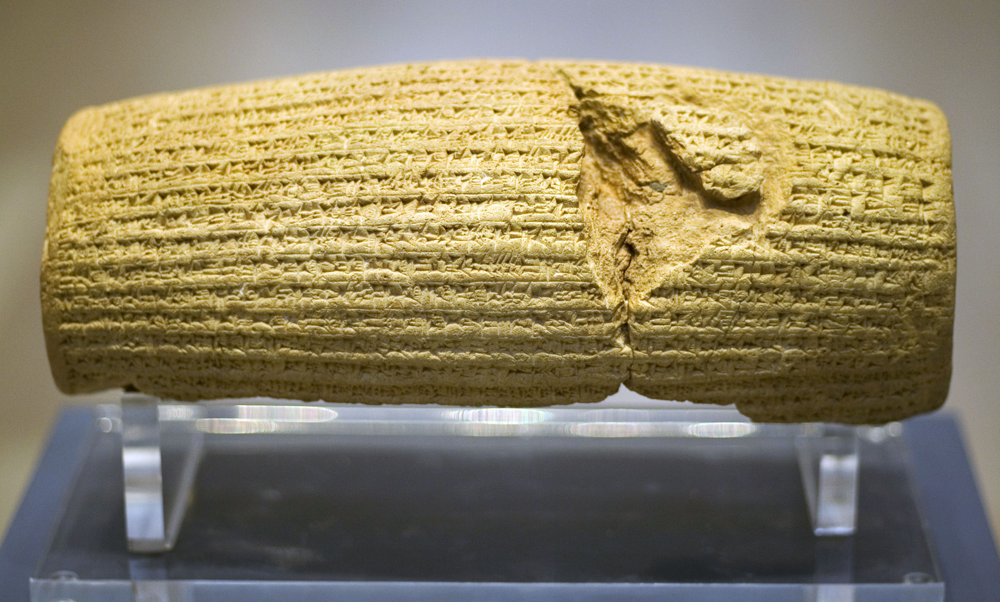
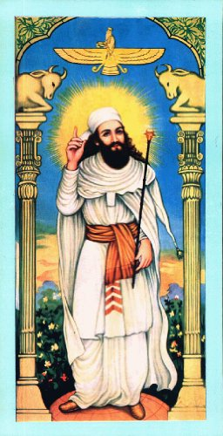
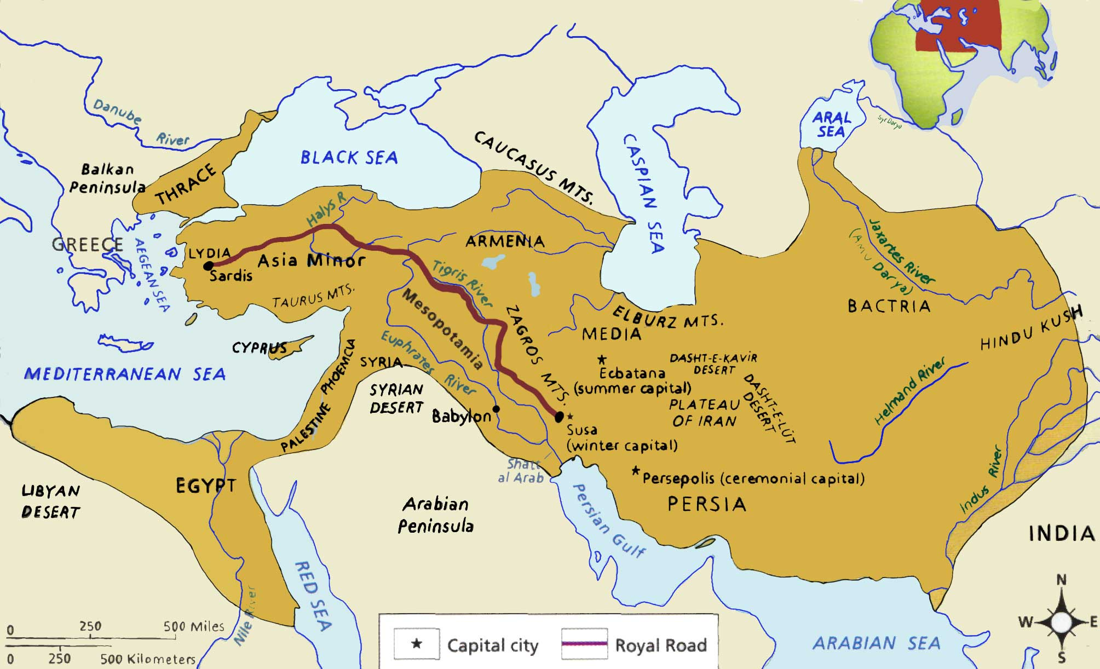
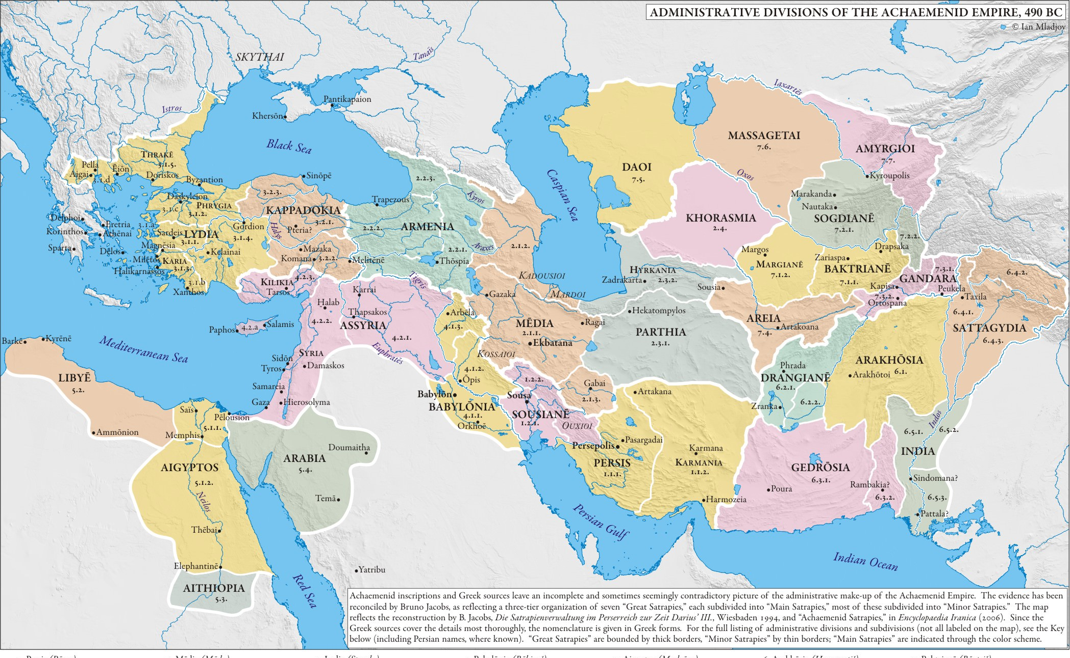
Persian Empire - Zoroastrianism
Notes:
Images: Cyrus Cylinder, Map of Empire with Royal Road, Map of Empire with satrapies, Zoroaster/Zarathustra

Slide 25
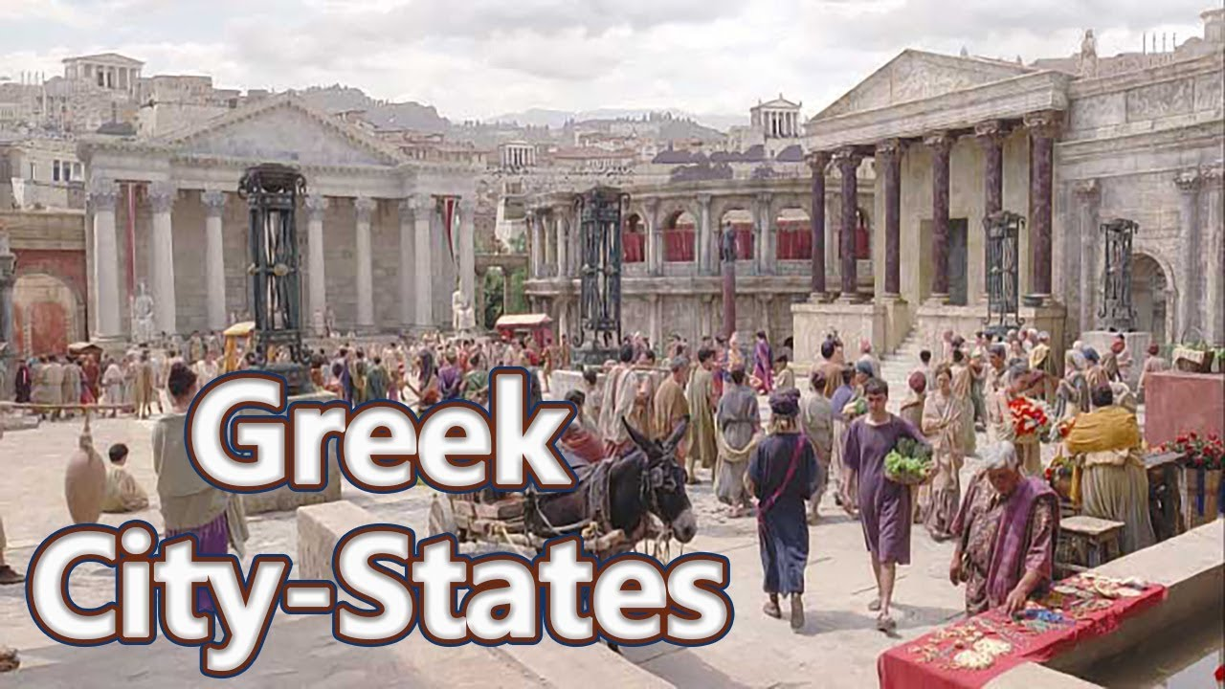
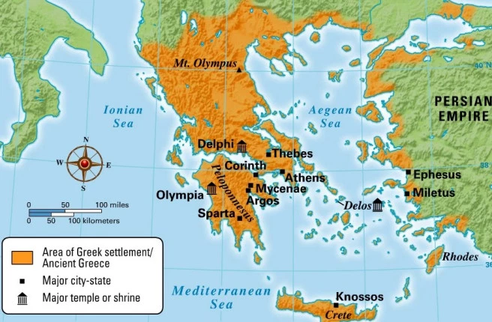
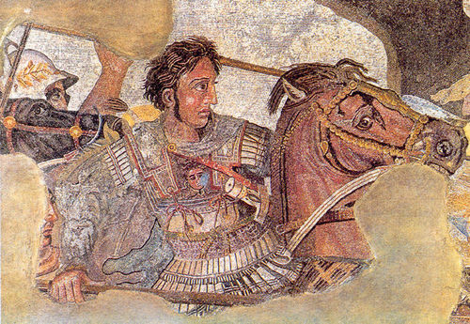
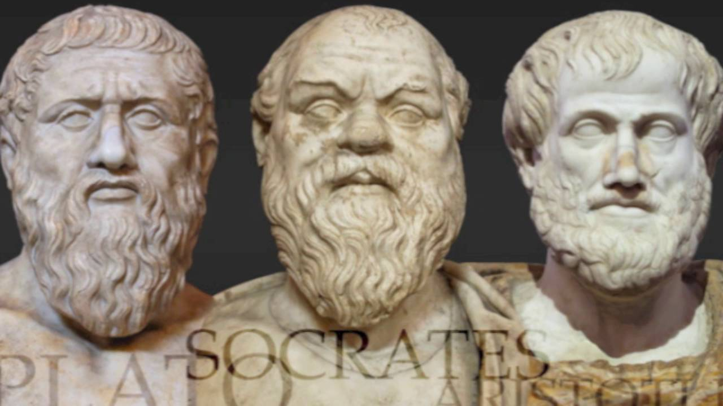
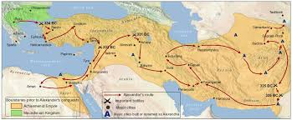
Greek City-States/ Greek Rationalism
Notes:
Images: Architecture/Democracy (Agora), Map of Greek city-states, Alexander & his empire; philosophers

Slide 26
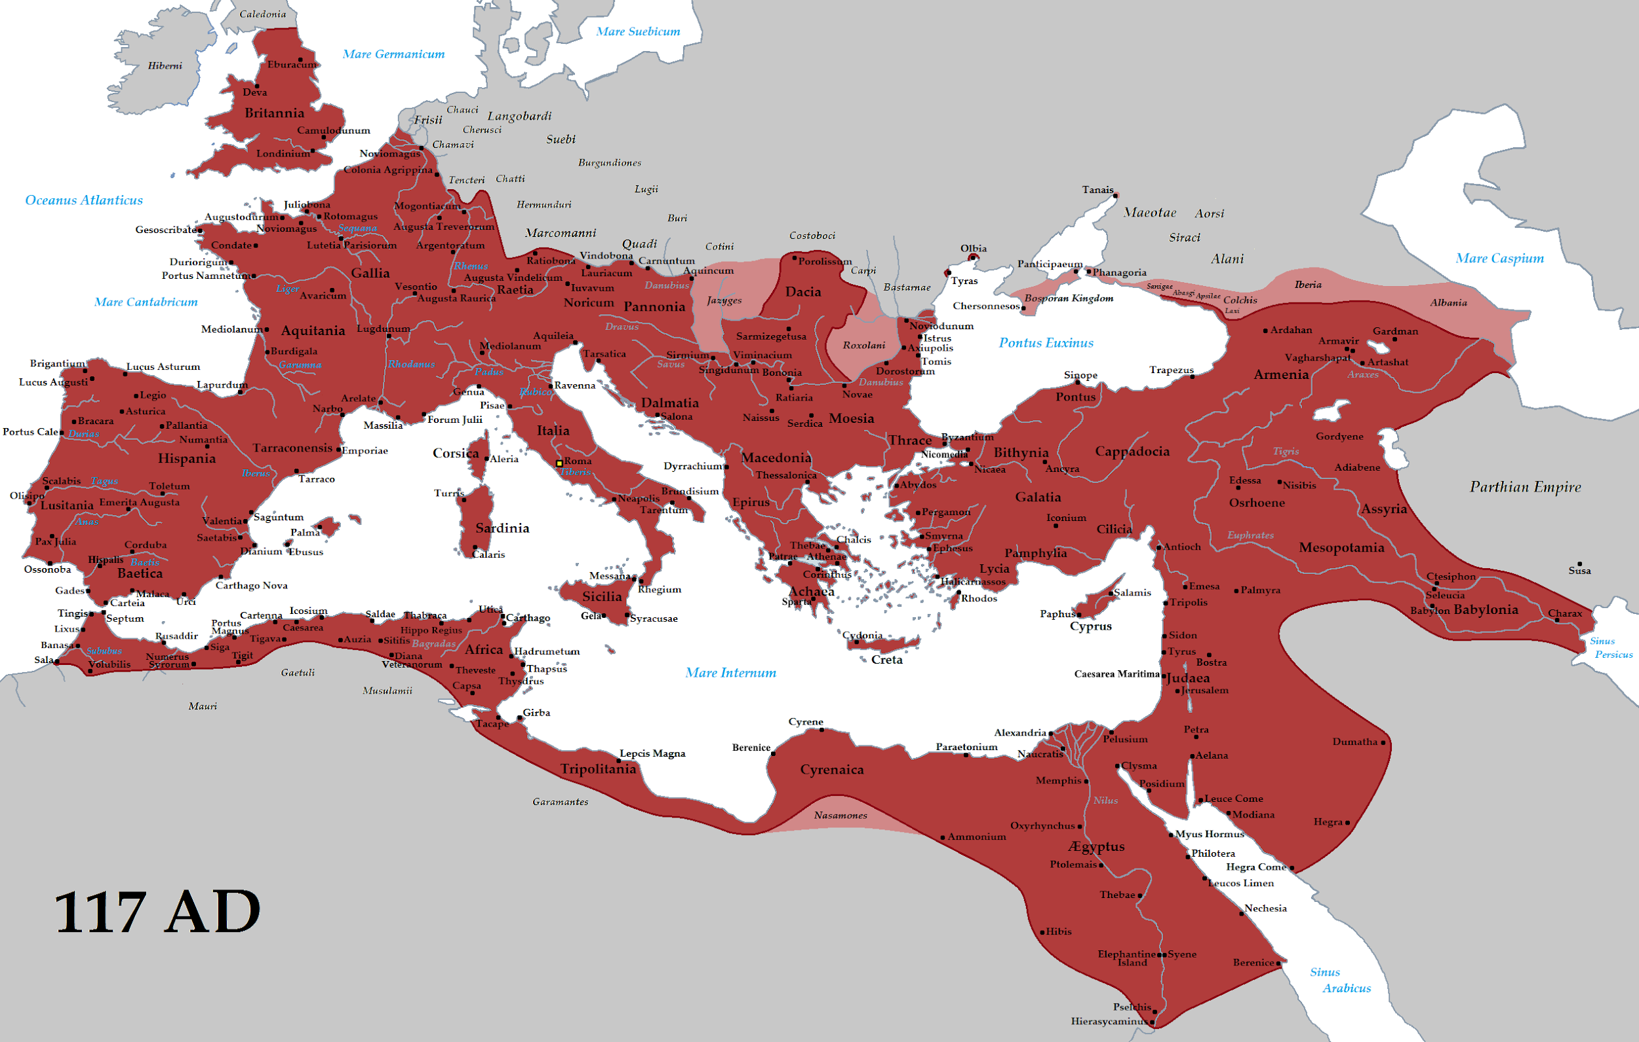
Civilizations of Western Eurasia & Christianity
Rome: Founded around 753 BCE.-476CE; representative democracy, law code-twelve tables--innocent until proven guilty; patriarchal society; women gained some rights (right to own property and initiate divorce proceedings)

Slide 27
Byzantine Empire
Roman Empire Constantine moved the capital of the Roman Empire from Rome to Constantinople in 330
In 395 the Roman Empire divided into the Eastern Roman Empire (Rome as capital) and the Western Roman Empire (Constantinople as the capital)
Constantinople was a political and economic hub.
Entrepôt: Coastal trading center--center of trade between Europe and Asia
Emperor Justinian the Great (527-565)
Hagia Sophia
Justinian Code: consolidation of Roman law codes; basis of 19th century European law codes

Slide 28
Hagia Sophia
What made the Hagia Sophia change over the years?
What do you think about it being a museum now rather than a church?

Slide 29
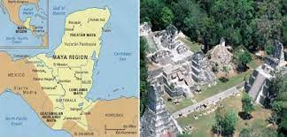
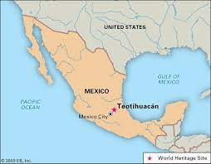
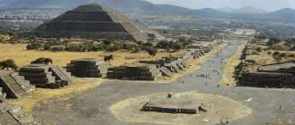
Early American Civilizations
Teotihuacan
Located near modern day Mexico City
By the 6th century CE it had a population of over 125,000 making it the largest city in the world at that time
Streets laid out in grids and monumental religious temples adorned the city
City was abandoned in 650 but would give rise to the Aztec Civilization
The Mayans
1500 BCE
Complex written language, accurate calendars, concept of zero (this occurred before Europeans did)

Slide 30
Comparisons in the Classical Age
Increased trade, technological innovation, and centralized governments worked together to make the lies of people longer, safer, and more comfortable.
Technological innovations--sail design and ship hulls; knowledge of monsoon winds; camel saddle; horse stirrups
Governments provided wealth and security to forster and sponsor trade.
Trade encouraged cultural exchange and goods over longer distances
Decline of Classical Empire
Challenges in collecting taxes
Declines in trade
Spread of disease
Social conflict caused by wealth disparity
attacks/invasions by outside groups

Slide 31
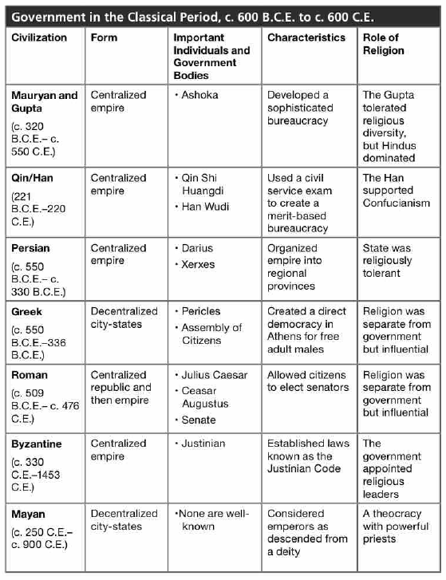

Slide 32
Crash Course Videos
#1 - Buddha & Ashoka
#2 - Persians & Greek
#3 - Alexander the Great
#4 - The Roman Empire

Slide 33
Part 3:
Postclassical Civilizations, c.600 CE-c.1200 CE

Slide 34
Postclassical Civilizations
Trade intensified greatly
Silk Road, Indian Ocean trade networks, and trans-Saharan trade routes
Goods: Porcelain, ivory, teakwood, spices, silk
New technologies and ideas: compass, astrolabe, new forms of credit, paper money, and new religious beliefs
Spread of disease

Slide 35
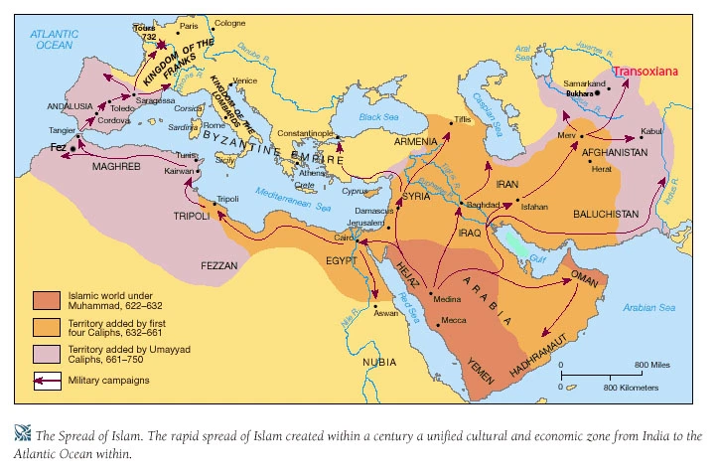
The Spread of Islam

Slide 36
Islam
Sunni: Caliph (leader) should be selected from all leaders in the Islamic community (majority of Muslims in the world)
Shi’a: Caliph should be a blood relative of Muhammad (strongest in Iran and Iraq)
Dar al-Islam: House of Islam--Islam united in S. Spain, N. Africa, the Middle East and parts of India
Abbasid Caliphate: Golden Age of Islam; stable government, trade prospered, advances in science and technology: algebra, astronomy, astrolabe, & preserved Greek and Roman text. Religious toleration (jizya-non-muslim tax); ended female infanticide and strengthed marriage and property rights of women

Slide 37
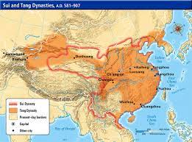
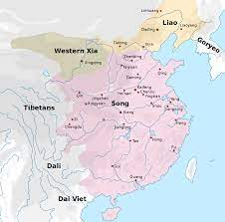
China
Sui Dynasty (581-618): centralized government; construction of grand canal; unified China
Tang Dynasty (618-907): extended boundaries to Mongolia (north) into central Asia and into Vietnam; population growth due to new variety of rice; expanded civil service exam and government bureaucracy; gunpowder, paper money; second golden age of silk roads
Song Dynasty: (960-1279) leading manufacturer of of iron, steel, silk, and porcelain; had largest cities in the world

Slide 38
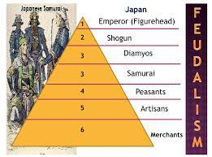
Japan
800-1200
Due to clan infighting, a strong political and social hierarchy developed to control the land
Shinto: official religion-beliefs centered on the veneration of ancestors and nature spirits
Missionaries came to spread Buddhism and it became popular; coexisted with Shinto

Slide 39
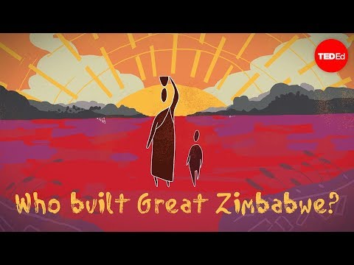
Africa
Self-governing chiefdoms
Diverse cultures
Ghana/West Africa (700-1240): trans-Sarhan trade routes; gold and salt trade; part of Dar al-Islam (still prodominiately Muslim area today)
East Africa: linked with Indian Ocean trade routes; exported gold, ivory, and enslaved peoples; imported porcelain, silk and spices
Great Zimbabwe:

Slide 40
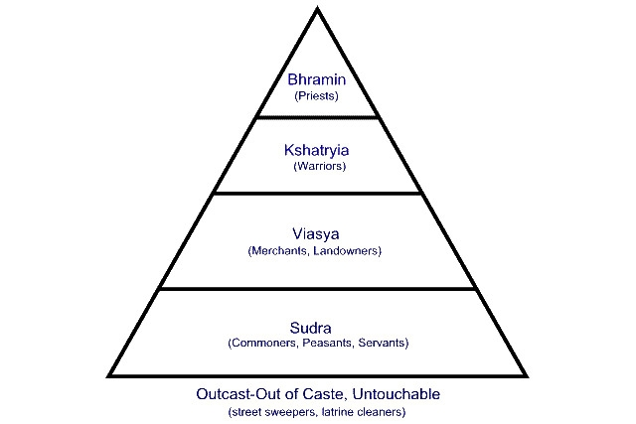
South Asia & Southeast Asia
South India remained relatively unified (because of Hinduism and the Caste System) while Northern India experienced invasions and weak centralized governments. Islam was able to spread to north India.
Indian Ocean trade routes flourished. Buddhist, Muslims and Hindus used trade routes to spread their religions. Goods such as silks, porcelain and horses were trades. Enslaved people were also traded.

Slide 41
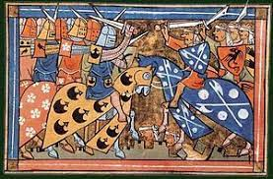
Europe
Invasions in Europe disrupted trade and society but also led to some cultural exchange (especially with the Vikings)
In 1054, the Eastern and Western Roman Empire split
1095-The Crusades
Called for by Pope Urban II for the Christains to take back control of Jerusalem from the Muslims

Slide 42
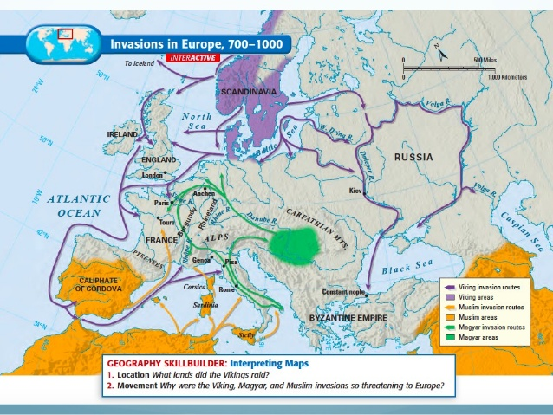
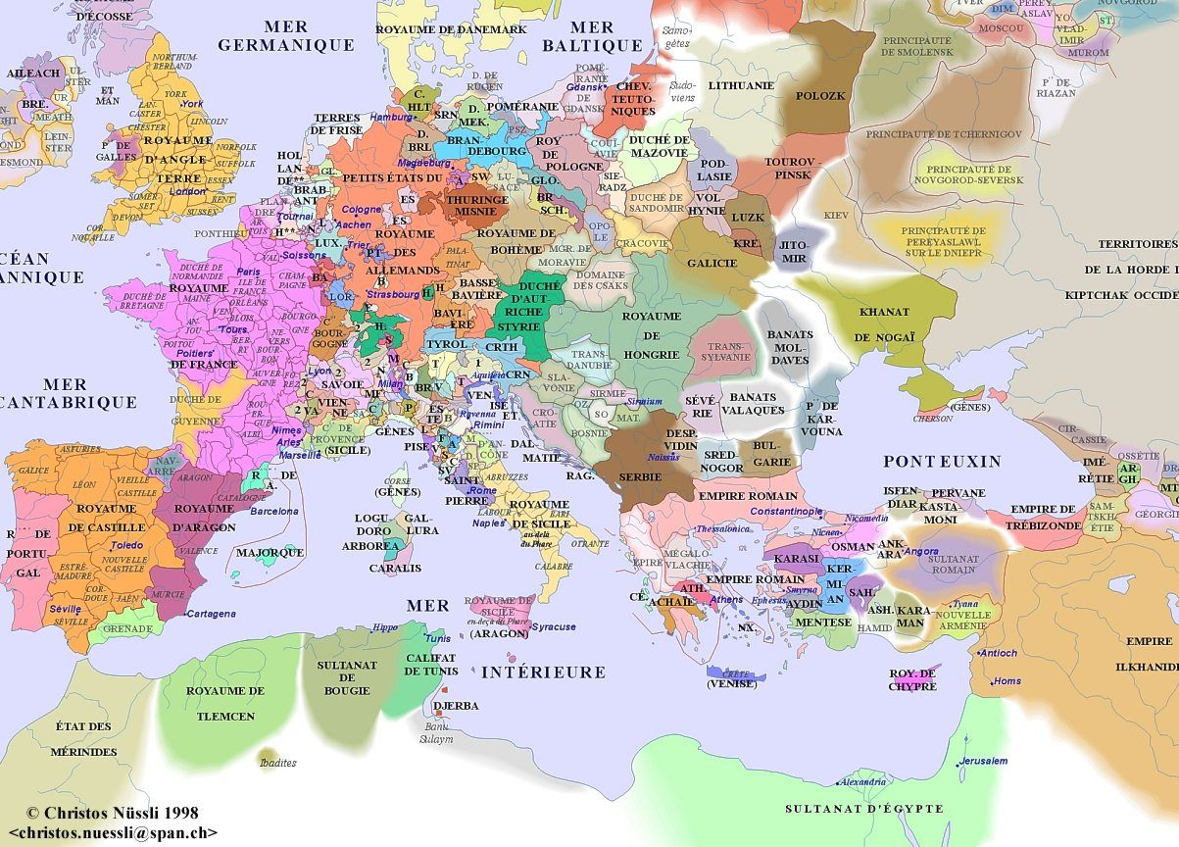
After the Fall of Rome - Invasions -
Decentralized- Break down of trade

Slide 43
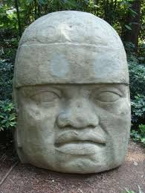
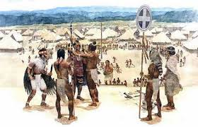
The Americas
By the year 900, the Mayan civilization golden age was ending caused by environmental degradation, drought and warfare.
Mississippian-8th-16th century; near St Louis; major trade hub
Toltecs: 10th century Mesoamerica; adopted many Mayan practices including religion; influenced the Aztecs

Slide 44
The World in 1200

Slide 45
Crash Course Videos
#1 - Fall of the Roman Empire

Slide 46
Key Terms by Theme
Society (Patterns) | Political (Classical) | Political (Postclassical) | Interaction with Environment (Food and trade)
Patriarchy Civil service exam Diaspora Entrepot Shogun daimyos | City-state Mauryan Empire Gupta Empire Mandate of Heaven Qin Han Persian Empire Greece Roman Empire Byzantine Empire | Abbasid Caliphate Sui Dynasty Tang Dynasty Song Dynasty Ghana Great Zimbabwe | Agricultural Revolution Pastoralism Monsoon winds
Culture (Religion) | Culture (Americas) | Economy(Trade) | Science
Hinduism Judaism Buddhism Confucius Daoism Christianity Islam Dar al-Islam Shinto Roman Catholic Church Orthodox Church | Teotihuacan Mayans Mississippian Toltecs | Silk Roads Indian Ocean Trade Routes Trans-Saharan trade routes | Cuneiform hieroglyphics ziggurats

Slide 47
Reflections:
Comparison: In what ways are Judaism, Islam, and Christianity alike?
Comparison: Describe the difference between centralized and decentralized civilizations and give an example of each.
Causation: Name at least 3 causes for the decline of classical civilizations.
Causation: Explain how trade networks caused Islam and Buddhism to spread.
Continuity: Identify a continuity that kept Southern India unified despite disruptions caused by the downfall of the Gupta Empire.
Change: Identify one new historical development after 600 CE.

Slide 48
Textbook/Supplemental Resources:
AMSCO: Prologue
World History For Us All: Big Era 2
World History for Us All: Big Era 3
Fivable - Unit 0 Review
World History BEFORE 1200 [AP World History Review] [Heimler’s History]
WHAP Unit 0: The First 10,000 Years of History in 20 Minutes [Anti-Social Studies History]
Adamson Adventure
SOCIALIS STUDIO

