Slide 1
Unit 1 Overview
State Building in Song China, Dar-al Islam, South and Southeast Asia, the Americas, Africa, and Europe.

Slide 2
Context Building
Before the year 1200, the world has already seen the rise and fall of many empires all around the world setting the stage for new states to develop, new religions to take hold, and new trade relationships to be built around the world.
Without the agricultural revolution (the neolithic revolution and the spread of agriculture), these periods of state building would not have been possible.

Slide 3
Topic 1.1 - Song China
Context leading up to 1200:
In a largely decentralized world, China had experienced decades of strong central control that resulted in a very prosperous China.
The Qin Dynasty (221 - 207) introduced a strong central bureaucracy that remained and expanded under Song China, showing an example of continuity in East Asia.
The Tang Dynasty improved agriculture, roads, and canals, which encouraged foreign trade and allowed Song China to be the economic powerhouse of the world in the post-1200 world
Bureaucracy in China:
China had a centralized imperial bureaucracy which required members of government to take merit exams.
Song China expanded the imperial bureaucracy, making it easier to lower class people to take the exam and enter the government.
This eventually hurt Song China, as the large bureaucracy became too expensive to maintain.
The Chinese Meritocracy system provided more upward mobility than any other government hiring system in the world at the time.

Slide 4
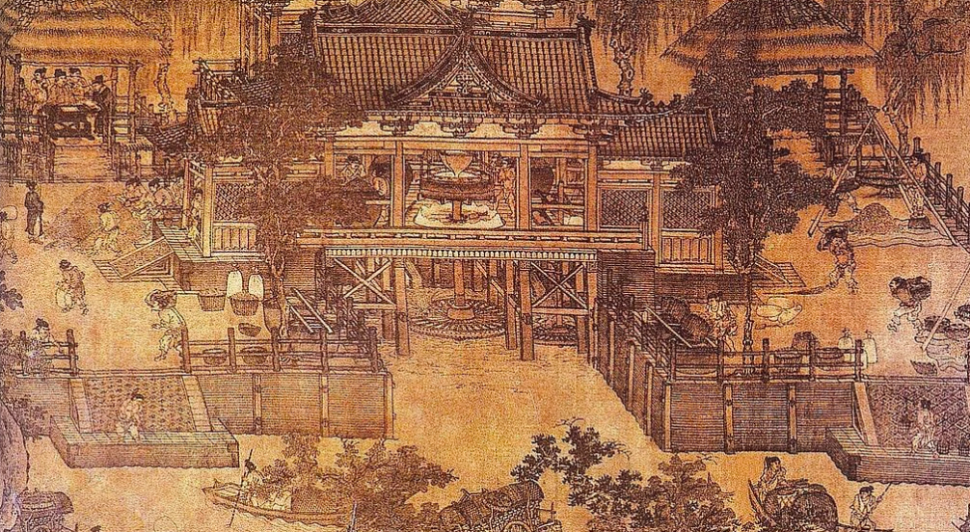
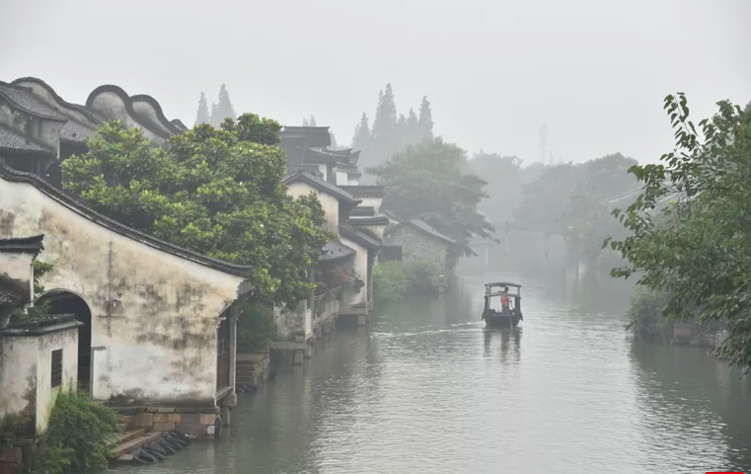
Innovation!
Song China innovated in many ways:
Grand Canal - Increased Trade - THEY’RE RICH!
Steel/Iron Production - Allowed farm tools to be stronger and more efficient.
Champa Rice - High caloric rice that grew in dry soil year around created a surplus in food.
Created unique porcelain and silk luxury goods that were highly desired trade goods.
These innovations allowed fewer people to farm, and more people to become artisans or laborers who lived in urban areas.
This is called proto-industrialization.

Slide 5
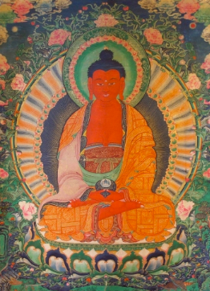
Religion in Song China
Confucianism, Buddhism, and Neo-Confucianism spread around Asia through trade and brought with it new ideas, art, and architecture.
Confucianism - The first major religion in Song China, Confucianism emphasized filial piety
This was the idea the men were the head of the household and their needs came first.
When new religions entered China, the government was hesitant to give up Confucianism and this idea.
Buddhism - Came to China on the SIlk Road
Combined with Taoism to create Zen-Buddhism.
Popular among Chinese people, but resisted by the Confucianists.
Neo-Confucianism - Rose in Song China as a response to the rise of Buddhism
Each of these impacted local areas like Korea, Japan, and Vietnam.

Slide 6
Topic 1.1 - Song China
Social Stratification
Song China was the most urbanized land in the world!
There was some social mobility in China, with the emperor at the top, the scholar gentry (those educated in Confucian philosophy) up next, followed by farmers, artisans and craftsmen, and the merchant class. At the bottom were peasants and the poor.
Women deferred to men for all things.
Foot Binding
Tributary System:
States surrounding China had to pay a tribute to China in the form of money or goods.
This continued to increase Chinese prosperity.
Japan, Korea, and Vietnam:
These regions were heavily influenced by China.
Japan - adopted Buddhism and Confucianism, but was not as centrally governed.
Korea was very close to China with a centralized system of government and the use of Confucianism and Buddhism.
Vietnam adapted the Chinese system of writing, but resisted sinification due to their unique views on the family and culture.

Slide 7
1.2
Dar-al Islam
1200-1450

Slide 8
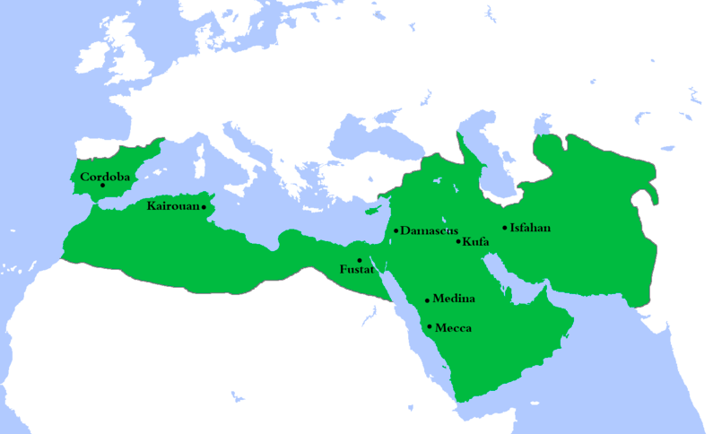
Context Building
After the death of Muhammed, Islam spread rapidly through military actions, merchants, and missionaries (THREE M’S) from Spain to India and from Egypt to Turkey.
After the fall of the pre-12oo Abbasid Caliphate, there was not one unified Islamic government, but regional Islamic empires collectively known as Dar-al Islam (everything Islam touches) made advances in math, literature, and medicine.

Slide 9
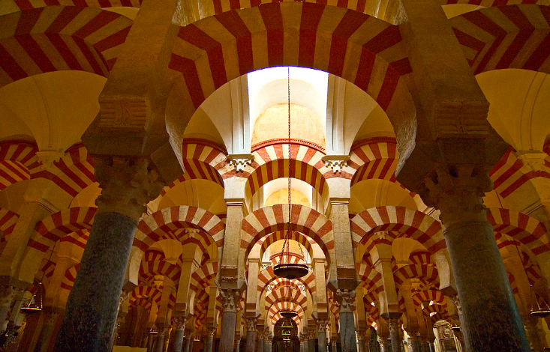
Topic 1.2 - Dar-al Islam: Various Islamic Empires
The following groups established their own Muslim empires after attacking and fragmenting the once unified Abbasid Caliphate.
Mamluk Empire
Turkish slaves working in Egypt who attacked and seized control of the Egyptian government created a Muslim empire across North Africa known as the Malmlu Sultanate
Seljuk Turks:
Muslim Turks who captured parts of the Middle East including Baghdad.
al-Andalus in Spain
Muslim empire in Spain that represents tolerance and collaboration between numerous religions in Muslim occupied territories.
al-Andalus today shows lots of Muslim influence in both its architecture and art.

Slide 10
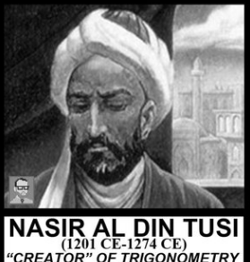
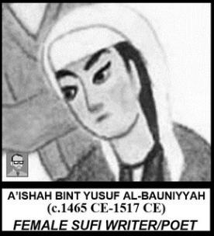
1.2 - Dar-al Islam: Innovations and Centers of Learning
Nasiral-Din al-Tusi
Celebrated Islamic Scholar who made advances in math that laid the groundwork for trigonometry.
A’ishah al-Ba’uniyyah
The most prolific female Muslim writer before the 20th century!
Medical Advances
Doctors and pharmacists begin studying for certification tests, greatly increasing standards of medical care
Cultural Continuities:
Islamic scholars were known for taking learning from numerous cultures and building upon it.
Translated Greek classics into Arabic
Studied math from India
Made paper from China

Slide 11
1.3
South and Southeast Asia

Slide 12
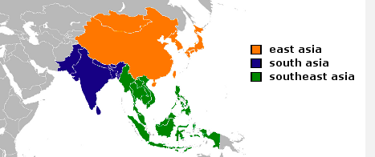
Context Building
In the pre-1200 world, the “Golden Age of India” ended when the Gupta empire fell, resulting in 1,000 years of decentralization.
South and Southeast Asia are characterized by interactions between Islam and Hinduism, the growth of trade, and the continuation of decentralized systems of government.

Slide 13
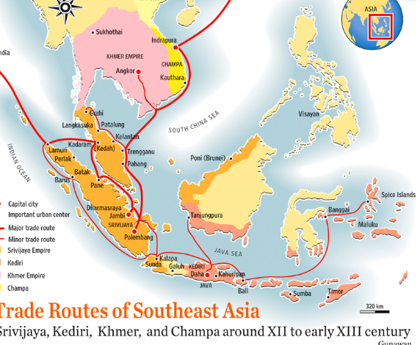
Overview
South and Southeast Asia were largely decentralized with regional empires growing over time.
This region was heavily influenced by the trade relationship it had with surrounding regions.
Islam greatly influenced the region, with many merchants converting to Islam to have a stronger trade relationships with Muslim nations.
Merchants are responsible for bringing Islam to Southeast Asia.
Some Hindus converted to Islam to escape the Caste system.

Slide 14
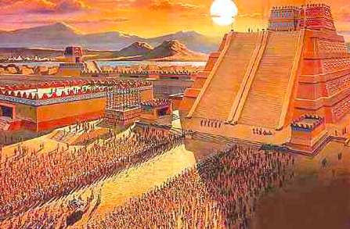
Topic 1.4 - State Building in the Americas

Slide 15
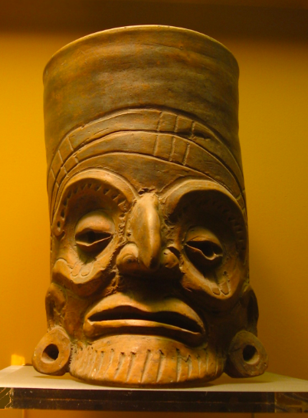
Topic 1.4 - Context
Aztecs (Mexica):
Arose in the 13th Century near lake Texcoco which allowed for farming, fishing, and transportation.
By 1434, Aztecs dominate the valley by conquering other city-states and creating a tribute empire.
They made surrounding regions pay them prisoners, goods, and money keeping the Aztecs rich and the others poor.
Capital city of Tenochtitlan was filled with farming, vasy palaces, and exciting markets!
Rulers were considered gods on earth giving them lots of power.
Pre-1200:
The first empire that grew in the Americas was the Toltec. They were highly militaristic with a heavy focus on sacrifice.
The Toltec empire probably fell due to repeated attacks by northern nomads.

Slide 16
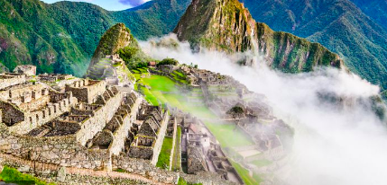
Topic 1.4 - Inca Empire
Centered around Lake Titicaca in Peru
Highly Centralized with a main ruler over four provinces.
Local leaders rule, but defer to the Inca
Created a Tribute Empire
Carpa Nan connected the large empire - one of the largest roads in the world at the time, with checkpoints throughout.
Advanced irrigation made the Inca skilled farmers.

Slide 17
Maps
Similarities | Differences
Built on earlier empires that preceded them (Aztecs = Toltecs; Inca = Chimor) | Aztecs have sophisticated traders and markets VS Inca have no specialized merchant class
Excellent imperial and military organizers | Aztecs have a writing system VS Inca do not
Highly organized agricultural sector under state control
Ethnic groups allowed to survive (Inca incorporate them into empire; Aztecs rule them harshly)
Animistic religions
No draft animals for labor
our office

Slide 18
Topic 1.4 - The Americas
Maya were decentralized with many Maya city-states spread throughout the region. They were often at war with each other.
Known for art, architecture, calendar, and astronomical system.
Other Tribes in the Americas:
Spread throughout the Americas, tribes were varied depending on their environment.
Most empires were weakened by European contact

Slide 19
Topic 1.5
State Building in Africa

Slide 20
Pre 1200:
Before Islam came to Africa, the societies were extremely diverse, Animistic and polytheistic, with varying economies.
Most people spoke the Bantu language.
The Bantu people, spread not only their language, but their knowledge of metalwork and agriculture throughout Africa.
Stateless Society:
Many African societies were stateless meaning they did not have an organized and centralized government.
Stateless society were largely weak with no tax systems or large building projects.
Islam:
Islam comes to Africa from missionaries and many convert because Islam was egalitarian with a focus on the authority of the king.
Conversion to Islam gave early African societies equal footing to Arabic societies.

Slide 21
Trans-Saharan Trade
Trade was improved by the use of camels and the camel saddle and caravans.
Trade allowed empires to grow along the network through importing their goods and trading with other kingdoms.
West African Empires - Ghana, Mali, and Songhai
Became Islamic to grow political power.
Traded with other Muslim nations
Set up Tributary systems on a small scale.
Central Africa:
Islam did not spread to this region. It was difficult to travel here, and states formed more slowly without the Islamic influence.
Great Zimbabwe
Large and non-Islamic
Dominated African gold and trade on coastal ports in the Indian Ocean network.
Built a great wall for protection

Slide 22
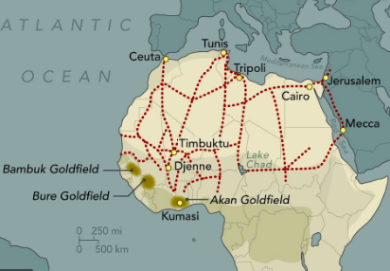
Ethiopia (Aksum)
Link between the Arab and Mediterranean world.
Exposed to Judaism, Christianity, and Islam
LOTS of trade because proximity to Eurasia
Global Connections:
Spread of Islam opened Africa up to global trade, but most of Africa developed independently.

Slide 23
Topic 1.6
Developments in Western Europe

Slide 24
Topic 1.6 - Developments in W. Europe
Pre-1200:
After the fall of the Roman Empire, W. Europe was left mostly decentralized.
The middle ages were a time of “backwardness” in Europe were governments were weak and learning was slow compared to the rest of te world.
Around 1100 Europe slowly begins to come out of the Middle ages.
Religion:
Christianity was the main religion throughout W. Europe, and while many places traded with Asia, Africa, and Arab nations, there was a deep fear of other religions.

Slide 25
Topic 1.6 - Western Europe
In a time of decentralization, religion held many places in Europe together.
The Catholic Church was highly organized and it became the most powerful institution in Europe. It was highly corrupt in many places.
Christian crusades tried to end Muslim rule in the Holy Land. It was successful in some places, but most importantly it opened the West up to trade.

Slide 26
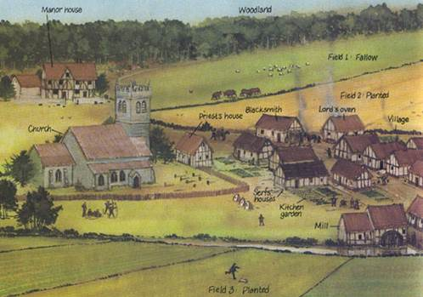
Topic 1.6 - West Europe
Manorialism:
Existed during a time of decentralization
Land owners would have peasants (serfs) work and live on their land.
In exchange, the Lord of the manor would provide protection for the serf.
Manors were isolated with low levels of production and low technology.
Very vulnerable to Viking raids due to their isolation.
Not the best system, but it did create a system of local rule with regional aristocrats.

Slide 27
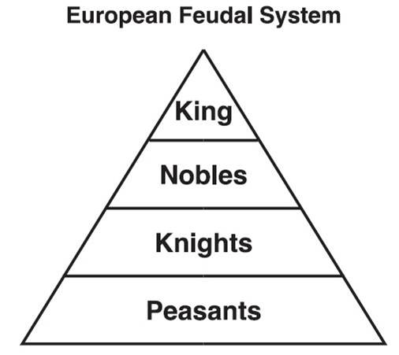
Topic 1.6 - West Europe
Feudalism:
Replaced Manorialism.
A military and political system that provided more protection from Viking Raids.
Rules provide protection and aid to lesser lords (vassals/nobles)
Nobles employ Knights for protection. And Peasants worked the land in exchange for protection and somewhere to live.
They were essentially slaves to the king.
A feudal monarch slowly grew and manors were absorbed into larger kingdoms.
Over time, feudalism created a very unhappy population of peasants.

Slide 28
Topic 1.6 - West Europe
Results:
Over time, Feudalism slowly transforms into a Monarchy, with many movements in place to limit both the Catholic Church and the Feudal system.
The High Middle Ages was a time where Feudalism decreased and industrialization increased
This lead to an increase in education and urbanization.
Agriculture improves and technology begins to catch up with the rest of the world. .
The Plague!
Around 1300, the Black Death starts to spread around Europe.
½ of the European population dies, and the labor force of Europe is slashed, making Feudal lords want a tighter hold on their peasants.
Peasants start to revolt against their working conditions, and checks were put in place against the Feudal lords.
Many people form Guilds to control working conditions.

